Slide 1
Structure of OS

Slide 2
An operating system has a complex structure, so we need a well-defined structure to assist us in applying it to our unique requirements.
Just as we break down a big problem into smaller, easier-to-solve subproblems, designing an operating system in parts is a simpler approach to do it.
And each section is an Operating System component.
The approach of interconnecting and integrating multiple operating system components into the kernel can be described as an operating system structure.
As mentioned below, various sorts of structures are used to implement operating systems.

Slide 3
There are five structures of operating system
Simple Structure
Monolithic Structure
Layered Approach Structure
Micro-kernel Structure
Modules

Slide 4
Simple Structure
It is the simplest Operating System Structure and is not well defined;
It can only be used for small and limited systems.
In this structure, the interfaces and levels of functionality are not well separated;
hence programs can access I/O routines which can cause unauthorized access to I/O routines.
This structure is implemented in MS-DOS operating system:
The MS-DOS operating System is made up of various layers, each with its own set of functions.
These layers are:
Application Program
System Program
MS-DOS device drivers
ROM BIOS device drivers

Slide 5
Layering has an advantage in the MS-DOS operating system since all the levels can be defined separately and can interact with each other when needed.
It is easier to design, maintain, and update the system if it is made in layers.
So that's why limited systems with less complexity can be constructed easily using Simple Structure.
If one user program fails, the entire operating system gets crashed.
The abstraction level in MS-DOS systems is low, so programs and I/O routines are visible to the end-user, so the user can have unauthorized access.

Slide 6
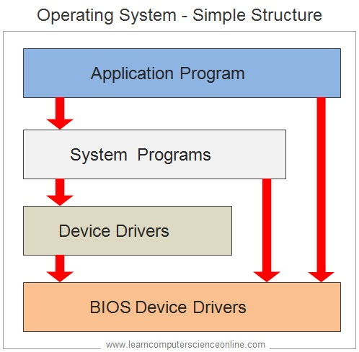
Layering in simple structure is shown below:

Slide 7
Advantages of Simple Structure
It is easy to develop because of the limited number of interfaces and layers.
Offers good performance due to lesser layers between hardware and applications.
Disadvantages of Simple Structure
If one user program fails, the entire operating system crashes.
Abstraction or data hiding is not present as layers are connected and communicate with each other.
Layers can access the processes going in the Operating System, which can lead to data modification and can cause Operating System to crash.

Slide 8
Monolithic Structure
The Monolithic operating System in which the kernel acts as a manager by managing all things like file management, memory management, device management, and operational processes of the Operating System.
The kernel is the heart of a computer operating system (OS).
Kernel delivers basic services to all other elements of the System.
It serves as the primary interface between the Operating System and the hardware.
In monolithic systems, kernels can directly access all the resources of the operating System like physical hardware, Keyboard, Mouse etc.

Slide 9
The monolithic kernel is another name for the monolithic operating system.
Batch processing and time-sharing maximize the usability of a processor by multiprogramming.
The monolithic kernel functions as a virtual machine by working on top of the Operating System and controlling all hardware components.
This is an outdated operating system that was used in banks to accomplish minor activities such as batch processing and time-sharing, which enables many people at various terminals to access the Operating System.
A Diagram of the Monolithic structure is shown below:

Slide 10
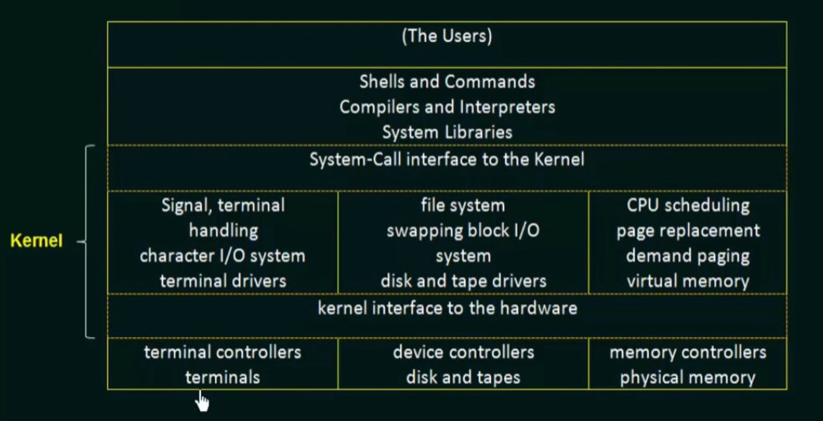
Fig. Monolithic Kernel system

Slide 11
Advantages of Monolithic structure:
It is simple to design and implement because all operations are managed by kernel only, and layering is not needed.
As services such as memory management, file management, process scheduling, etc., are implemented in the same address space, the execution of the monolithic kernel is relatively fast as compared to normal systems.
Using the same address saves time for address allocation for new processes and makes it faster.
Disadvantages of Monolithic structure:
If any service in the monolithic kernel fails, the entire System fails because, in address space, the services are connected to each other and affect each other.
It is not flexible, and to introduce a new service.

Slide 12
Layered Approach
In this type of structure, OS is divided into layers or levels.
The hardware is on the bottom layer (layer 0), while the user interface is on the top layer (layer N).
These layers are arranged in a hierarchical way in which the top-level layers use the functionalities of their lower-level levels.
In this approach, functionalities of each layer are isolated, and abstraction is also available.
In layered structure, debugging is easier as it is a hierarchical model, so all lower-level layered is debugged, and then the upper layer is checked.
So all the lower layers are already checked, and the current layer is to be checked only.

Slide 13
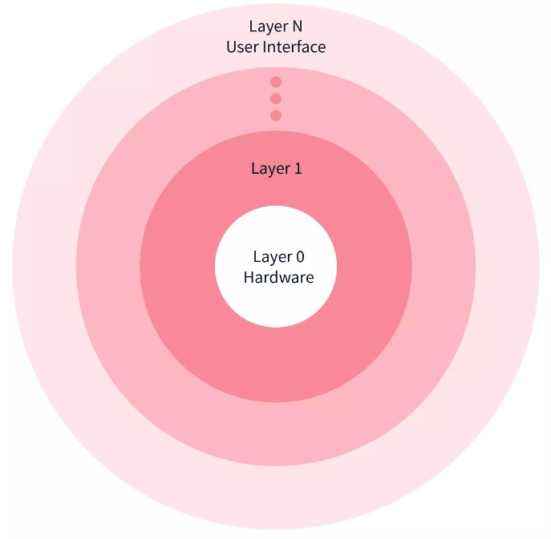
Below is the Image illustrating the Layered structure in OS:
Fig. Layered Structure

Slide 14
Advantages of Layered Structure
Each layer has its functionalities, so work tasks are isolated, and abstraction is present up to some level.
Debugging is easier as lower layers are debugged, and then upper layers are checked.
Disadvantages of Layered Structure
In Layered Structure, layering causes degradation in performance.
It takes careful planning to construct the layers since higher layers only utilize the functions of lower layers.

Slide 15
Micro-kernel
Micro-Kernel structure designs the Operating System by removing all non-essential components of the kernel.
These non-essential components of kernels are implemented as systems and user programs.
Hence these implemented systems are called as Micro-Kernels.
Each Micro-Kernel is made independently and is isolated from other Micro-Kernels.
So this makes the system more secure and reliable.
If any Micro-Kernel fails, then the remaining operating System remains untouched and works fine.

Slide 16
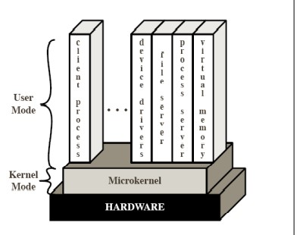
Fig. Micro kernel operating system

Slide 17
Advantages of Micro-kernel structure:
It allows the operating system to be portable between platforms.
As each Micro-Kernel is isolated, it is safe and trustworthy.
Because Micro-Kernels are smaller, they can be successfully tested.
If any component or Micro-Kernel fails, the remaining operating System is unaffected and continues to function normally.
Disadvantages of Micro-kernel structure:
Increased inter-module communication reduces system performance.
System is complex to be constructed.

Slide 18
Modules
-Most modern operating systems implement kernel modules
-Uses object-oriented approach
-Each core component is separate
-Each talks to the others over known interfaces
-Each is loadable as needed within the kernel
-Overall, similar to layers but with more flexible

Slide 19
The best current methodology for operating-system design involves using loadable kernel modules.
Here, the kernel has a set of core components and links in additional services via modules.
The idea of the design is for the kernel to provide core services while other services are implemented dynamically, as the kernel is running.
Linking services dynamically is preferable to adding new features directly to the kernel, which would require recompiling the kernel every time a change was made.

Slide 20
This system is more flexible than a layered system, because any module can call any other module.
The approach is also similar to the microkernel approach in that the primary module has only core functions and knowledge of how to load and communicate with other modules, but it is more efficient.
Because modules do not need to invoke message passing in order to communicate.
The Solaris operating system structure is organized around a core kernel with seven types of loadable kernel modules:

Slide 21
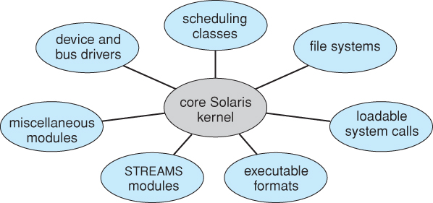
Fig. Modules

